Slide 1
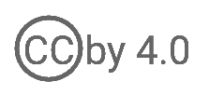
Single Sign-On
WSO2 Identity Server Fundamentals

Slide 2




Application Ecosystem
A typical organization has to manage multiple applications
HR Application
Accounts Application
Application User
[John Doe]
Sales Application

Slide 3

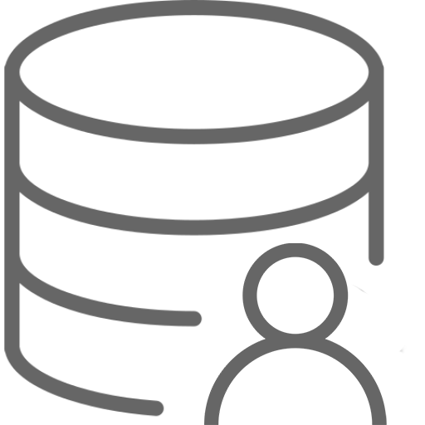
Centralized Access Control
Centrally manage user accounts and apply control policies
a
HR Application
Accounts Application
Application User
[John Doe]
Userstore
[LDAP]
Sales Application

Slide 4
Concerns with a Centralized Access Control System
Low Productivity
Poor User Experience
Cost of Development
Low Agility

Slide 5


Seamless Access with SSO
Sign in to one application and gain access to all the other applications sharing the same session
Userstore
1
HR Application
2
Identity Provider (IdP)
WSO2 Identity Server
Accounts Application
Application User
[John Doe]
3
Sales Application

Slide 6
Open Standards
For seamless integration between applications and identity providers
Userstore
OIDC
HR Application
SAML
Identity Provider (IdP)
WSO2 Identity Server
Accounts Application
Application User
[John Doe]
WS-Federation
Sales Application

Slide 7
Quick Recap

Slide 8

Overview to application ecosystem
Centralized access control vs. SSO
Open standards for SSO
What you learnt

Slide 9



Any Questions ?
Reach us through the following channels
iam-dev@wso2.org
https://stackoverflow.com/questions/tagged/wso2-identity-server
https://discord.com/invite/Xa5VubmThw

Slide 10
Thank you!
Notes:
Acknowledge that it’s been a lot of changes within the team
Thank you for your taking onboard the feedback and being open to change.
A lot of work , a lot of learning, sometimes feeling twice the exhaustion
But also hopefully seeing what I see, which is: better ways of working, more innovation in our approach, more business acumen, more effective reactivity , more ahead of the game. Because that’s where marketing needs to be.
All this in a context where it’s also been a lot of changes for WSO2.
And from this standpoint I wanted to remind you of what Sanjiva said about you owning the culture

